Slide 1
The Prompt

Slide 2
“Everyday [students] can unlock insane potential if only they are given basic foundational training”
Jeremy Utley Director of Executive Education at Standford
Notes:
Encourage to take notes: https://psycnet.apa.org/doiLanding?doi=10.1037%2Fa0030367

Slide 3
Is prompting a programming language?
Notes:
Encourage to take notes: https://psycnet.apa.org/doiLanding?doi=10.1037%2Fa0030367

Slide 4

Anonymous 7th Grader
From Ohio
What is creativity?
“Creativity is doing more than the first thing that you think of.”
Einstellung Effect – Humans tend to fixate on the early solution and just be satisfied.
Satisficing = satisfy + suffice
Once we get to “good enough,” it’s enough
Notes:
Herbert A. Siomon in 1956

Slide 5
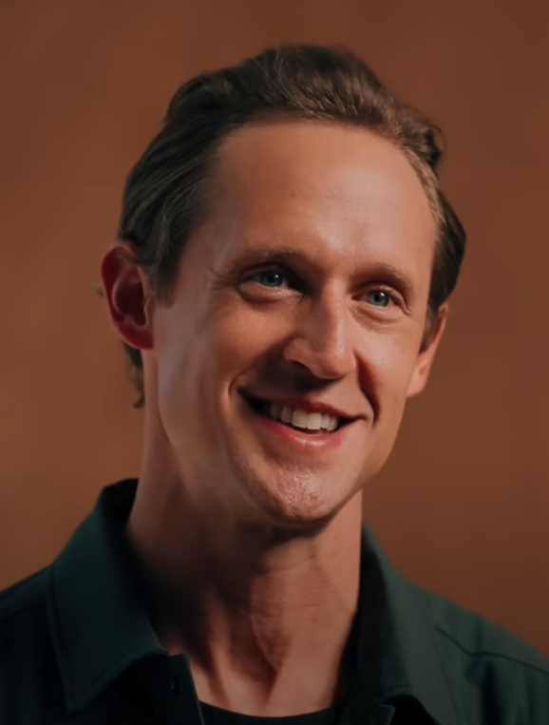
Jeremy Utley
Director of Executive Education at Standford
Study in Europe and United States showed that AI made people less creative
Less than 10% of working professionals are driving meaningful productivity gains from AI
Underperformers used AI like a tool
Outperformers treated AI like a teammate

Slide 6
What do you do if it gives you mediocre results?
If it’s a tool
Maybe you improve it
Maybe you say it’s no good at doing that
If it’s a teammate
You give them feedback
You give them coaching
You give them mentorship
You help them improve it
Help it ask you questions

Slide 7

Hayden Miyamoto
CEO of Acquira
Serial entrepreneur with 30 businesses
Spend around 5 hours a day with AI
Master Prompt Method

Slide 8
Master Prompt
Personal
Company
Market Information
Competitors, what do they do
Team + KPIs
Reports, what do they do
Products/Services
Culture
Core values / Mission
Protocols

Slide 9

The Token

Slide 10
What is a token?
“I want to purchase an RV from Bish’s”
35 Characters – 9 tokens
[40, 1682, 316, 7314, 261, 38030, 591, 140663, 885]

Slide 11
Transformers
Bish
Walmart
Facebook
the
my
Amazon
31%
Transformer
7%
I want to purchase an RV from _______
6%
4%
3%
3%
Temperature 0.0 = The highest probable
2.0 = One of the higher probable

Slide 12
Transformers - Attention Layers
I
want
to
purchase
an
RV
from
___
Attention
1.2
4.0
1.3
4.1
1.3
9.1
3.4
3.2
5.6
3.2
6.3
8.1
6.2
6.3
2.3
1.2
3.4
1.1
3.5
4.5
1.1
2.3
1.2
4.2
7.2
0.1
1.6
8.4
4.2
4.2
5.4
1.2
3.0
3.3
8.3
1.6
1.2
4.1
2.3
6.4
.
.
.
.
.
.
.
.
.
.
.
.
.
.
.
.
0.2
4.5
5.2
1.3
6.3
1.2
9.1
3.6

Slide 13
Repeated Attention Layers
I
want
to
purchase
an
RV
from
___
1.2
4.0
1.3
4.1
1.3
9.1
3.4
3.2
1.2
4.0
1.3
4.1
1.3
9.1
3.4
3.2
5.6
1.2
3.2
4.0
6.3
1.3
8.1
4.1
6.2
1.3
6.3
9.1
2.3
3.4
1.2
3.2
5.6
1.2
3.2
4.0
6.3
1.3
8.1
4.1
6.2
1.3
6.3
9.1
2.3
3.4
1.2
3.2
3.4
5.6
1.1
3.2
3.5
6.3
4.5
8.1
1.1
6.2
2.3
6.3
1.2
2.3
4.2
1.2
3.2
3.4
1.2
1.1
4.0
3.5
1.3
4.5
4.1
1.1
1.3
2.3
9.1
1.2
3.4
4.2
1.2
7.2
5.6
0.1
3.2
1.6
6.3
8.4
8.1
4.2
6.2
4.2
6.3
5.4
2.3
1.2
4.2
3.4
5.6
1.1
3.2
3.5
6.3
4.5
8.1
1.1
6.2
2.3
6.3
1.2
2.3
1.2
1.2
7.2
3.4
0.1
1.1
1.6
3.5
8.4
4.5
4.2
1.1
4.2
2.3
5.4
1.2
6.4
4.2
3.0
7.2
3.3
0.1
8.3
1.6
1.6
8.4
1.2
4.2
4.1
4.2
2.3
5.4
1.2
4.2
3.0
3.4
3.3
1.1
8.3
3.5
1.6
4.5
1.2
1.1
4.1
2.3
2.3
1.2
6.4
1.2
.
.
7.2
.
.
0.1
.
.
1.6
.
.
8.4
.
.
4.2
.
.
4.2
.
.
5.4
.
.
6.4
3.0
7.2
3.3
0.1
8.3
1.6
1.6
8.4
1.2
4.2
4.1
4.2
2.3
5.4
.
.
1.2
.
.
3.0
.
.
3.3
.
.
8.3
.
.
1.6
.
.
1.2
.
.
4.1
.
.
2.3
6.4
.
.
3.0
.
.
3.3
.
.
8.3
.
.
1.6
.
.
1.2
.
.
4.1
.
.
2.3
.
.
6.4
0.2
.
.
4.5
.
.
5.2
.
.
1.3
.
.
6.3
.
.
1.2
.
.
9.1
.
.
3.6
.
.
0.2
.
.
4.5
.
.
5.2
.
.
1.3
.
.
6.3
.
.
1.2
.
.
9.1
.
.
3.6
.
.
0.2
4.5
5.2
1.3
6.3
1.2
9.1
3.6
0.2
4.5
5.2
1.3
6.3
1.2
9.1
3.6
0.2
4.5
5.2
1.3
6.3
1.2
9.1
3.6

Slide 14
Predict What it Knows
___
want
___
___
___
___
I
___
___
___
think
will
call
like
have
am
31%
1.2
4.0
1.3
4.1
1.3
9.1
3.4
3.2
28%
1.2
4.0
1.3
4.1
1.3
9.1
3.4
3.2
27%
5.6
1.2
3.2
4.0
6.3
1.3
8.1
4.1
6.2
1.3
6.3
9.1
2.3
3.4
1.2
3.2
5.6
1.2
3.2
4.0
6.3
1.3
8.1
4.1
6.2
1.3
6.3
9.1
2.3
3.4
1.2
3.2
3.4
5.6
1.1
3.2
3.5
6.3
4.5
8.1
1.1
6.2
2.3
6.3
1.2
2.3
4.2
1.2
25%
3.2
1.3
9.1
3.4
3.2
3.4
1.2
1.1
4.0
3.5
1.3
4.5
4.1
1.1
6.2
2.3
6.3
1.2
2.3
4.2
1.2
7.2
5.6
0.1
3.2
1.6
6.3
8.4
8.1
4.2
1.1
4.2
2.3
5.4
1.2
1.2
4.2
3.4
1.1
2.1
3.5
4.5
6.2
6.3
2.3
1.2
22%
7.2
5.6
0.1
3.2
1.6
6.3
8.4
8.1
4.2
1.1
4.2
2.3
5.4
1.2
1.2
4.2
3.0
3.4
3.3
1.1
8.3
3.5
1.6
4.5
1.2
4.2
4.1
4.2
2.3
5.4
6.4
1.2
7.2
0.1
3.3
1.6
8.4
1.1
2.3
1.2
4.2
3.0
3.4
3.3
1.1
8.3
3.5
1.6
4.5
1.2
4.2
4.1
4.2
2.3
5.4
6.4
1.2
16%
.
.
7.2
.
.
0.1
.
.
1.6
.
.
8.4
.
.
1.2
.
.
4.1
.
.
2.3
.
.
6.4
3.0
3.3
9.1
8.3
1.6
4.2
4.2
5.4
1.2
.
.
7.2
.
.
0.1
.
.
1.6
.
.
8.4
.
.
1.2
.
.
4.1
.
.
2.3
.
.
6.4
3.0
3.3
8.3
1.6
.
.
.
.
.
.
.
.
.
.
.
.
4.1
.
.
.
.
1.2
4.1
2.3
6.4
3.0
3.3
8.3
1.6
.
.
.
.
.
.
.
.
0.2
.
.
4.5
.
.
5.2
.
.
1.3
.
.
6.3
1.2
9.1
3.6
0.2
.
.
4.5
.
.
5.2
.
.
1.3
.
.
6.3
.
.
1.2
.
.
9.1
.
.
3.6
.
.
0.2
4.5
5.2
1.3
6.3
1.2
9.1
3.6
0.2
4.5
5.2
1.3
6.3
1.2
9.1
3.6
2.8
6.3
1.2
9.1
3.6
0.2
4.5
5.2
1.3

Slide 15
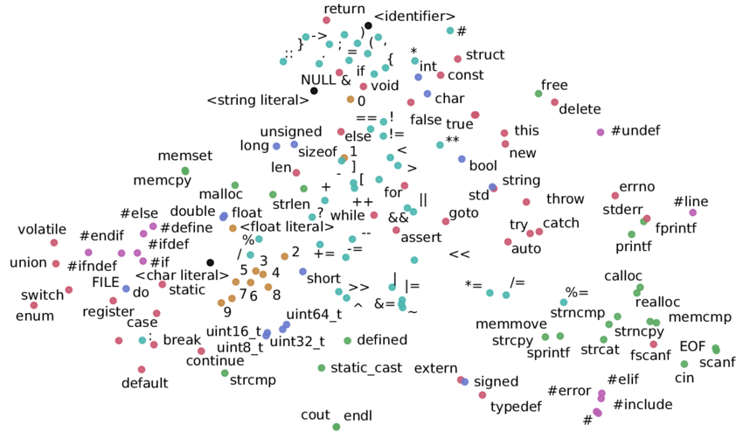
Word2Vec
Notes:
https://www.researchgate.net/figure/A-word2vec-embedding-of-tokens-from-C-C-source-code_fig3_328074198

Slide 16
Agenda
Understand how LLMs predict the next token
Demonstrate proven prompt engineering techniques
Explore use cases of AI

Slide 17
Selecting visual aids
Enhancing your presentation

Slide 18
Effective delivery techniques
This is a powerful tool in public speaking. It involves varying pitch, tone, and volume to convey emotion, emphasize points, and maintain interest:
Pitch variation
Tone inflection
Volume control
Effective body language enhances your message, making it more impactful and memorable:
Meaningful eye contact
Purposeful gestures
Maintain good posture
Control your expressions

Slide 19
Navigating Q&A sessions
Know your material in advance
Anticipate common questions
Rehearse your responses
Maintaining composure during the Q&A session is essential for projecting confidence and authority. Consider the following tips for staying composed:
Stay calm
Actively listen
Pause and reflect
Maintain eye contact

Slide 20

Speaking impact
Your ability to communicate effectively will leave a lasting impact on your audience
Effectively communicating involves not only delivering a message but also resonating with the experiences, values, and emotions of those listening

Slide 21
Dynamic delivery
Learn to infuse energy into your delivery to leave a lasting impression.
One of the goals of effective communication is to motivate your audience.
Metric | Measurement | Target | Actual
Audience attendance | # of attendees | 150 | 120
Engagement duration | Minutes | 60 | 75
Q&A interaction | # of questions | 10 | 15
Positive feedback | Percentage (%) | 90 | 95
Rate of information retention | Percentage (%) | 80 | 85

Slide 22
Final tips & takeaways
Consistent rehearsal
Strengthen your familiarity
Refine delivery style
Pacing, tone, and emphasis
Timing and transitions
Aim for seamless, professional delivery
Practice audience
Enlist colleagues to listen & provide feedback
Seek feedback
Reflect on performance
Explore new techniques
Set personal goals
Iterate and adapt

Slide 23
Speaking engagement metrics
Impact factor | Measurement | Target | Achieved
Audience interaction | Percentage (%) | 85 | 88
Knowledge retention | Percentage (%) | 75 | 80
Post-presentation surveys | Average rating | 4.2 | 4.5
Referral rate | Percentage (%) | 10 | 12
Collaboration opportunities | # of opportunities | 8 | 10

Slide 24
Thank you
Brita Tamm
502-555-0152
brita@firstupconsultants.com
www.firstupconsultants.com

